Slide 1
Front End Engineering-I Project
Team Details:
Faculty Coordinator:
RAGHAV MEHNDIRATTA
RANJAN MINHAS
RAKSHAN SHARMA
Mrs AMANDEEP KAUR
:
Chitkara University Institute of Engineering and Technology,
Chitkara University, Punjab

Slide 2
Table of Contents
Introduction
Problem Statement
Technical Details
Key Features
Project Highlights
Conclusion
References/Links used

Slide 3
Introduction
Caffe Management
System
A Cafe management system is a type of point-of-sale (POS) software specifically designed for cafes, restaurants, bars, food trucks and others in the foodservice industry.
Cafe Management System is based on a concept to maintain orders and management of a particular items. This project is developed in HTML and CSS. The role of the User is to maintain information including operations like modifying, deleting, updating the items records and customer order records in the system.

Slide 4
Problem Statement
Managing a Cafe manually is not an easy task. It requires man-power and time. So as to overcome this problem, making a cafe management site is an efficient step as it not only decrease the work load but also helps in promoting the website through social media platforms.
Some major Problems:
• Manual billing may result in errors, and handling payments can be time-consuming.
• Managing inventory manually can be time-consuming and error prone.
• Incorrect orders and misunderstandings can lead to customer dissatisfaction.
• Updating menus and prices manually can lead to inconsistencies and delays.
• Maintaining data security and preventing fraud is crucial in handling customer information and transactions.
• Lack of insights into cafe performance can hinder strategic decision-making.

Slide 5
Technical Details
Languages used:
HTML
CSS
JAVASCRIPT
Code Editor Used:
Visual Studio Code
Brower’s Used:
Chrome
Firefox
Microsoft Edge
System details:
Processor : AMD Ryzen 5 3450U with Radeon Vega Mobile Gfx
Installed Ram : 8 GB

Slide 6
Key Features
(1) Point-of-sale system
(2) Payment processing
(3) Cafe inventory management
(4) Reservation or table management solution
(5) Online or e-commerce system
(6) Online Ordering System

Slide 7
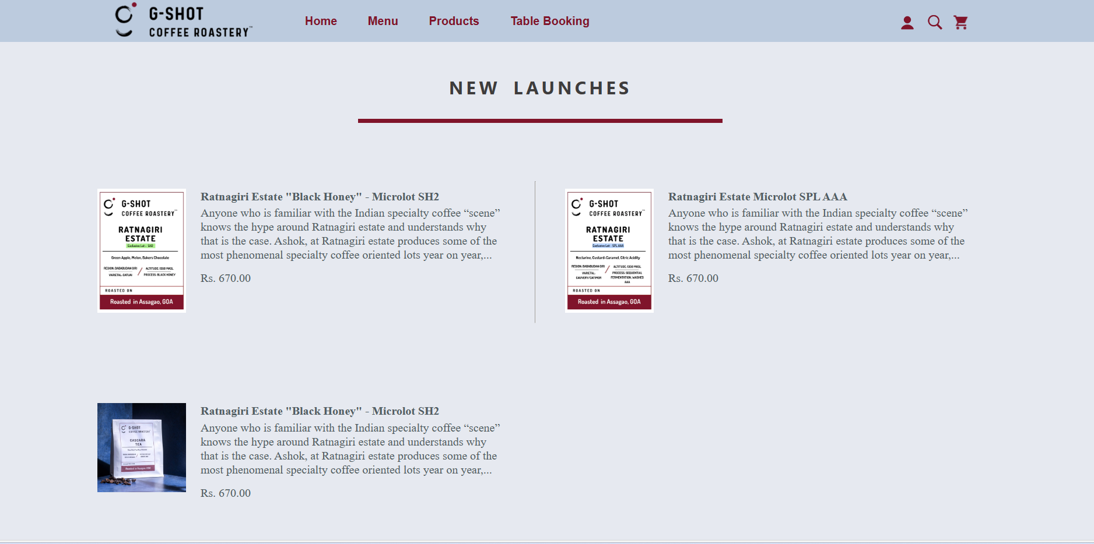
Project Highlights

Slide 8
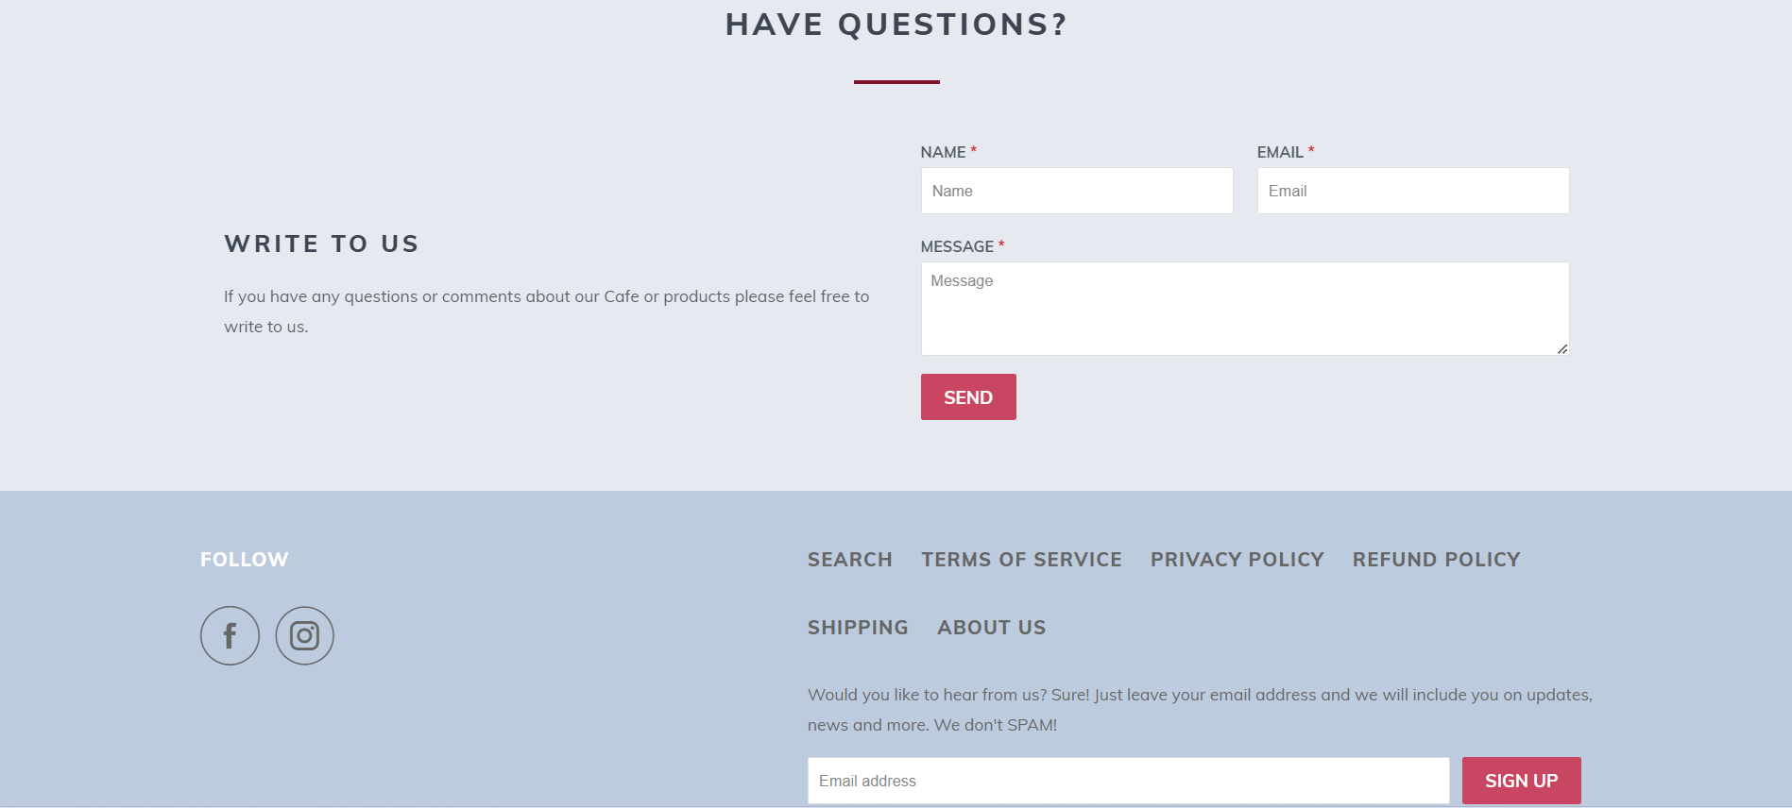

Slide 9
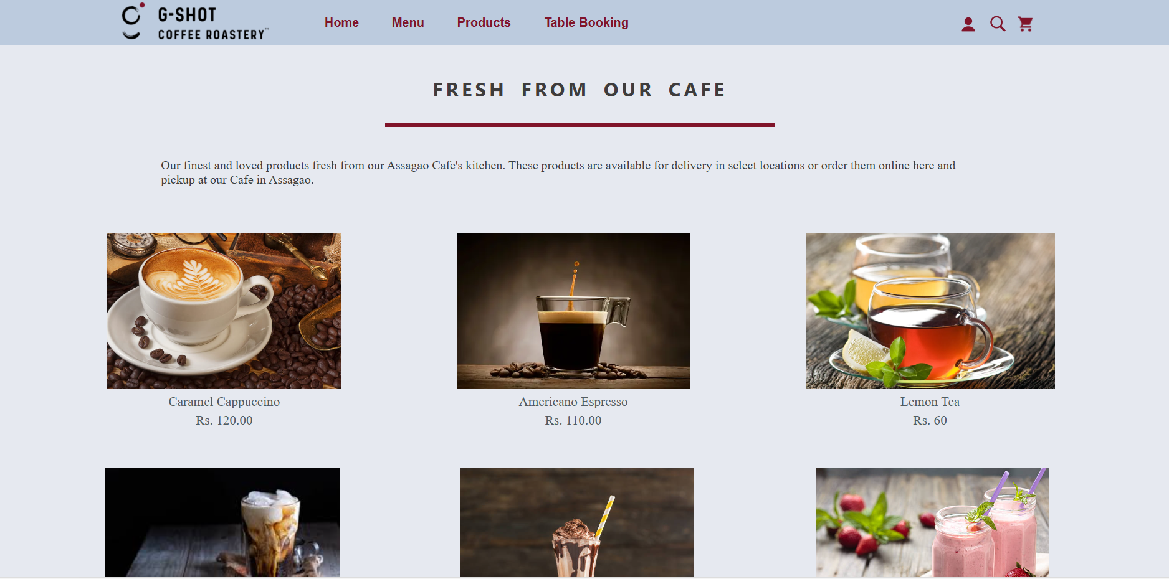

Slide 10
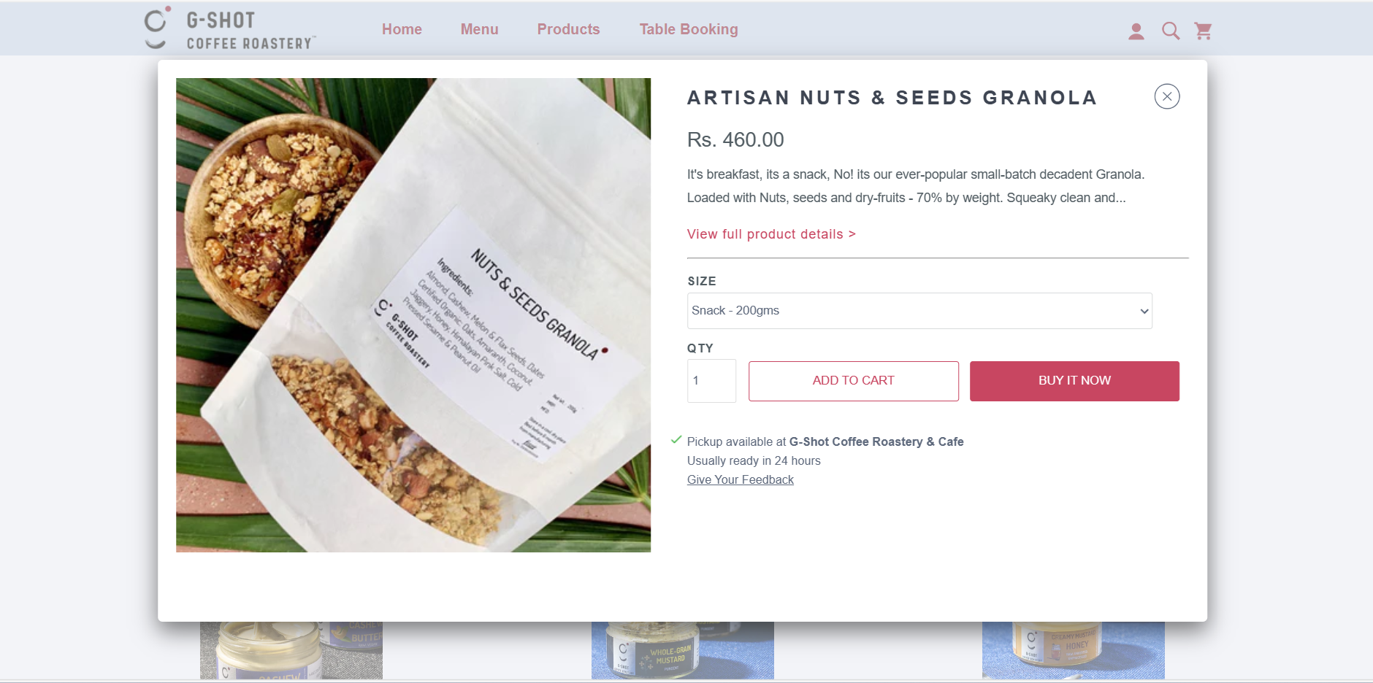

Slide 11
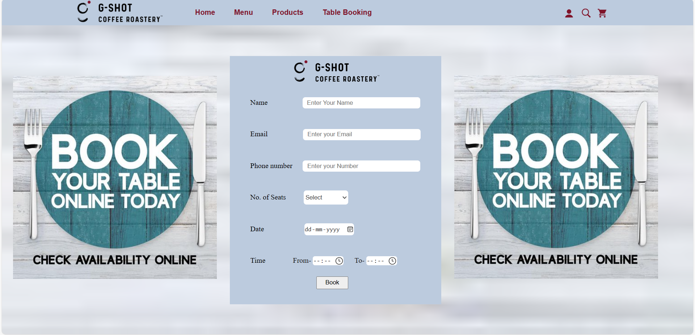

Slide 12
Conclusion
Everything is upgrading with time very quickly as technology is evolving in this modern era. Like every other business restaurants should also consider using modern technologies to stay ahead.
The restaurant management system is very advanced software with seamless features and countless advantages. The advantages of restaurant management system include better customer service, employee satisfaction, cost reduction, more revenue and so much more.
Some major advantages of using a Café Management System are:
Better Customer Service
Keeping Track of Sales
Improved Reporting
Advance Security
Fewer Errors
More Productivity
Effective use of Time
Track Your Inventory
Reduce Cost

Slide 13
References/Links used
[1] https;//getbootstrap.com
[2] GOOGLE ICONS CANVA STUDIO.
[3] https://gshotcoffeeroastery.com

Slide 14


